Slide 1
ACCIDeNtS Automatic car Crashes and incidents detection and notification system
Scientific Coordinator
Lect. Dr. Vârlan Cosmin
Proposed by
Cîtea Alexandra-Florentina

Slide 2
CONTENTS
Introduction
Used technologies
ACCIDeNtS – flow presentation
Conclusions

Slide 3
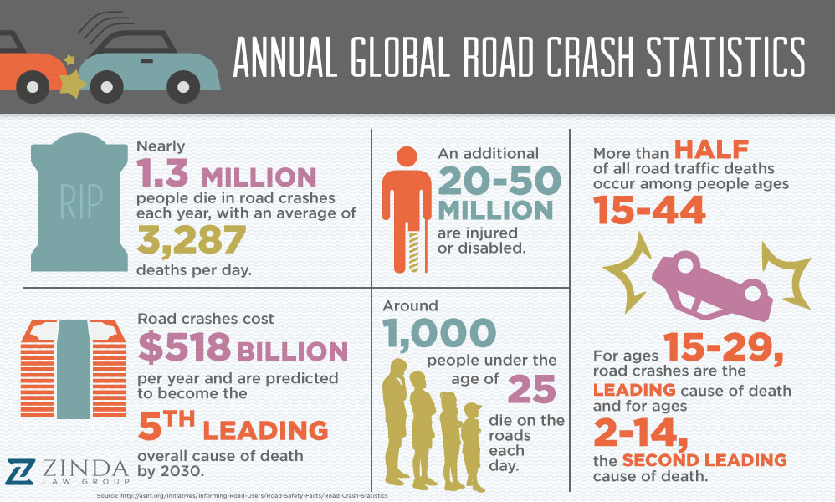
Introduction
Problem
An important number of accidents occur in a remote area in which help takes longer to come.
PURPOSE
Save lives.
Raise awareness.
Demonstrate the ease of implementing such a system.

Slide 4
USED TECHNOLOGIES
OBD II
Bluetooth
Raspberry Pi / Arduino
GSM/GPS
Fuzzy logic
Django
CoolTerm
SQLite3

Slide 5
ACCIDENTS
In-car Component
01
External Component
02
ACCIDeNt application
03

Slide 6




ACCIDeNtS in-car component
The ELM327 transmits the data to the Raspberry Pi via Bluetooth
Fuzzy Logic classifies the accident
The Raspberry Pi gets the coordinates and sends the SMS via a SIM808 module
RPI
ELM327
SIM808

Slide 7

ACCIDeNtS in-car component
Inside the Raspberry Pi
Received data inserted in the database
Processing the codes
Searching for an accident
Classify the accident via fuzzy logic
Getting the location
Sending the SMS to the external component
83
F1
12
41
0D
A1
D4
data

Slide 8

ACCIDeNtS external component
4. The SMS is received by another SIM808 module
The Arduino “catches” the SMS and expose the data to the serial
CoolTerm writes the data into a file
A python script inserts the data into the application’s database
ARDUINO
SIM808
FILE

Slide 9

ACCIDeNtS ACCIDENTS application
Informational-purpose application which displays the accidents and the units from the database on a Google Map

Slide 10
TESTS
Skoda Octavia 2 (2009) 1.9 TDI
Flat portion of the road
100% accuracy for detecting potential accidents
94 % accuracy for locating the accident ( 300-850m error range)
Test no. | Max speed | Max RPM | Results | Priority
1 | 40 | 1500 | Not accident | -
2 | 40 | 2500 | Not accident | -
3 | 50 | 1300 | Not accident | -
4 | 50 | 2000 | Not accident | -
5 | 60 | 1000 | Not accident | -
6 | 60 | 1500 | Accident | 0
7 | 80 | 1500 | Accident | 0
8 | 80 | 2500 | Accident | 1
9 | 100 | 2000 | Accident | 1
10 | 100 | 3000 | Accident | 2
11 | 120 | 2500 | Accident | 2
12 | 120 | 3500 | Accident | 2

Slide 11
CONCLUSIONs
Precise and reliable
Easy way of combining technologies for saving lives
Better alternative to other on-the-market systems
Combining hardware and software
Compatible with older cars
Modularity
Possibility of improvements

Slide 12
DEMO

Slide 13
QUESTIONS

